Slide 1
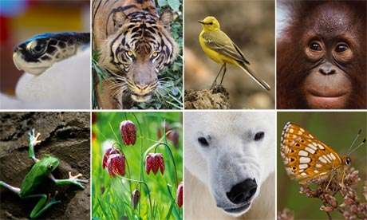
Unit 2
Biodiversity

Slide 2
Thinking Lab
Examine the following pictures and brainstorm a list of characteristics that enable you to separate living from non-living

Slide 3
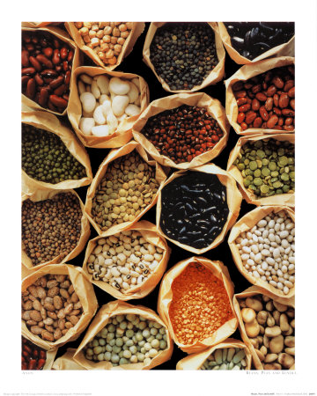
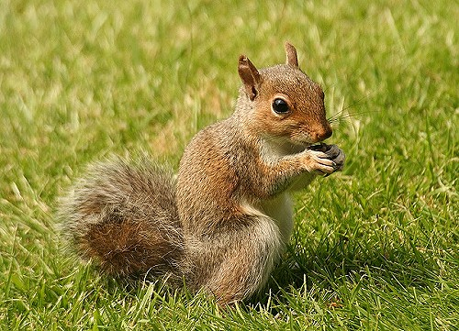
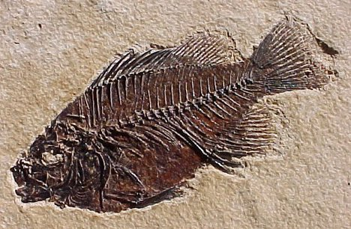
2
3
1
4
5

Slide 4
Characteristics of living things
Made of one or more cells
The ability to metabolize matter (photosynthesis/respiration)
Interact with their environment and maintain homeostasis
Grow and Develop
Reproduce
Adapt to their surroundings

Slide 5
1. Cells
Unicellular (one cell) or Multicellular (many cells)
Leads to more complex structures/organisms:
Tissues (epithelial tissue, muscle tissue)
Organs (heart, lungs, kidney)
Organ Systems (circulatory, respiratory, excretory)
http://www.bbc.co.uk/bitesize/ks3/science/organisms_behaviour_health/cells_systems/activity/

Slide 6
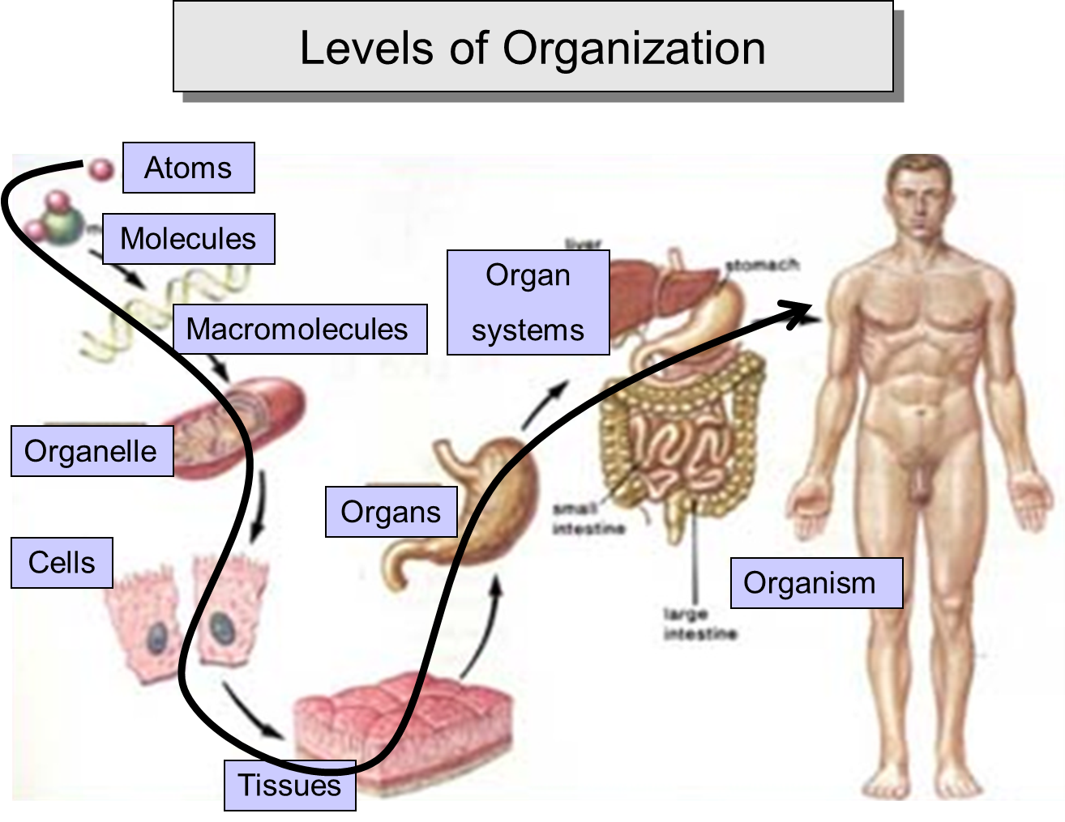

Slide 7
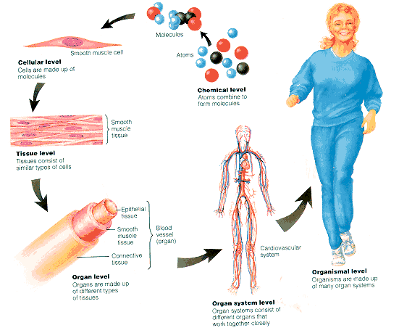

Slide 8
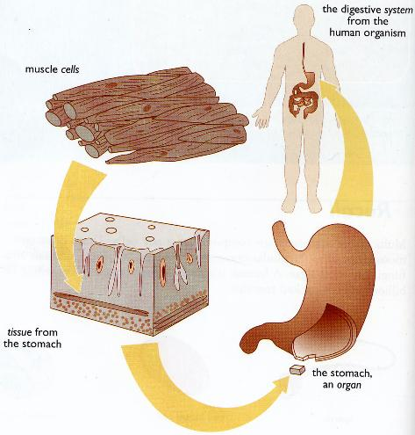

Slide 9
2. Metabolism
Metabolism means cells are able to obtain energy

Slide 10
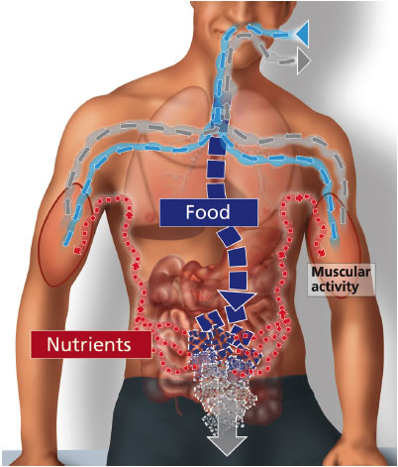

Slide 11
3. Living Things are Homeostatic
Homeostasis means staying the same. The inside of the cell must remain the same, despite changing external conditions

Slide 12
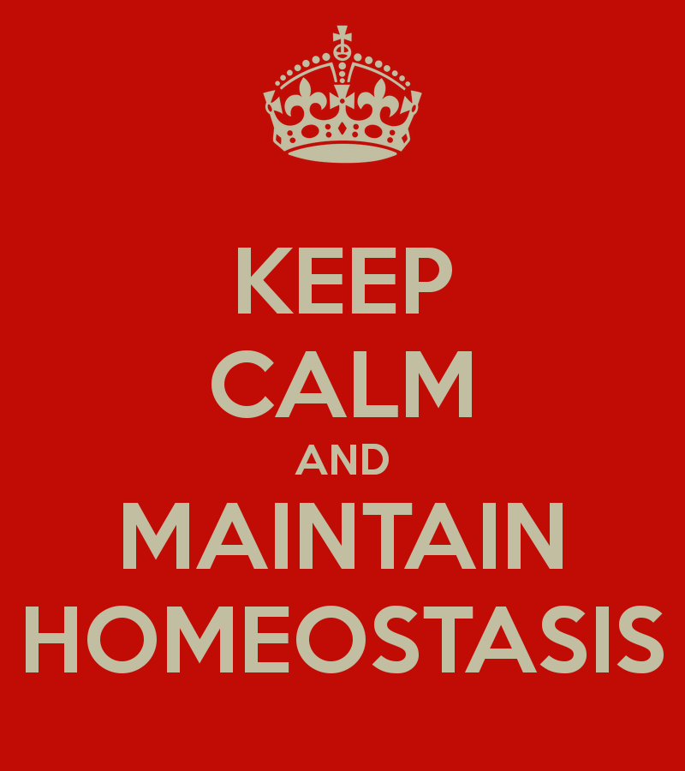

Slide 13
4. Living Things Undergo Biogenesis
All cells/organisms come from other living cells/organisms.
Unicellular organisms (asexual reproduction)
Multicellular organisms (sexual reproduction)

Slide 14
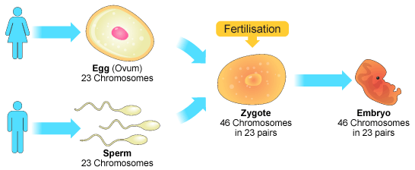
SEXUAL REPRODUCTION

Slide 15
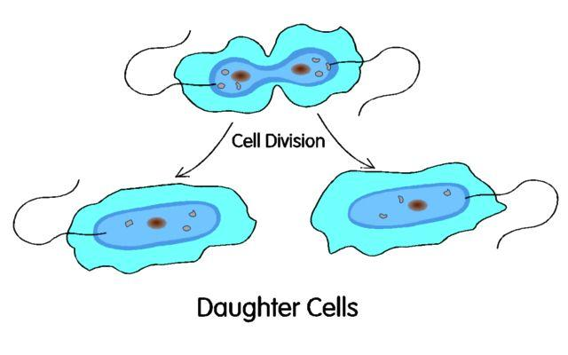
ASEXUAL REPRODUCTION

Slide 16
5. Living Things Adapt
All organisms must be able to adapt to their changing environment. This is none as “Survival of the fittest.” Organisms with the “best” adaptations survive to reproduce and pass on those genes to a new generation.

Slide 17
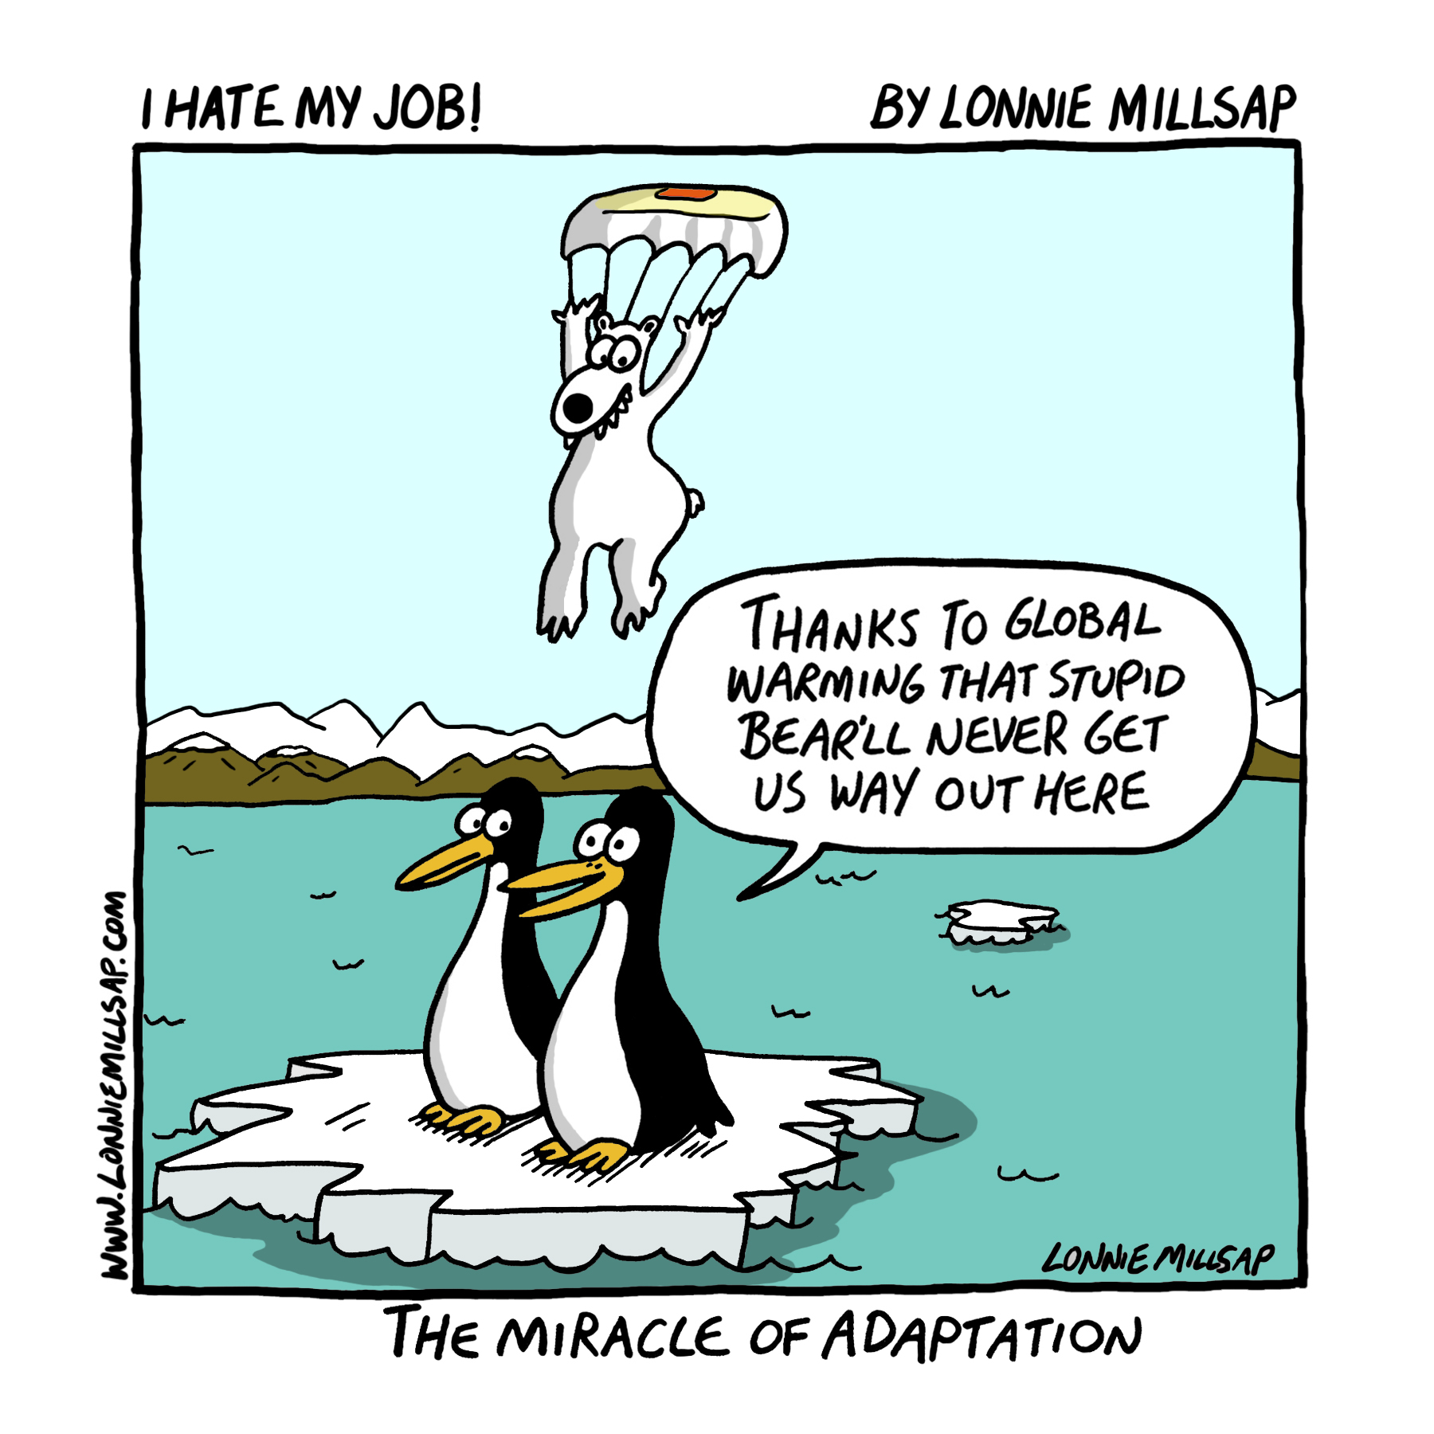

Slide 18
Classifying Living Things
The branch of biology that deals with the classification and naming of living organisms is called taxonomy.
Scientists have identified between 2 and 4.5 million different kinds of living organisms. Some estimate that there may be four times this number.

Slide 19
Scientists
Aristotle - the first to classify organisms. He classified all organisms as either plants or animals.
Linnaeus - considered to be the father of taxonomy. Used the physical and structural features of an organism for classification. The more features that organisms have in common, the closer the relationship.

Slide 20
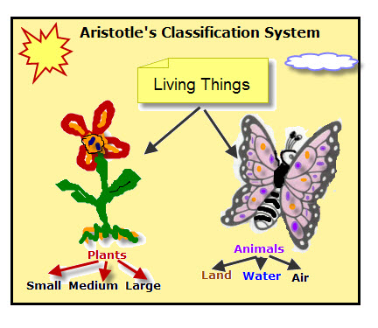

Slide 21
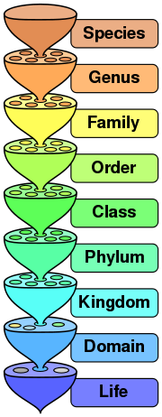
Each type of organism belongs to one kingdom, one phylum, one class, one order, one family, one genus and one species.

Slide 22
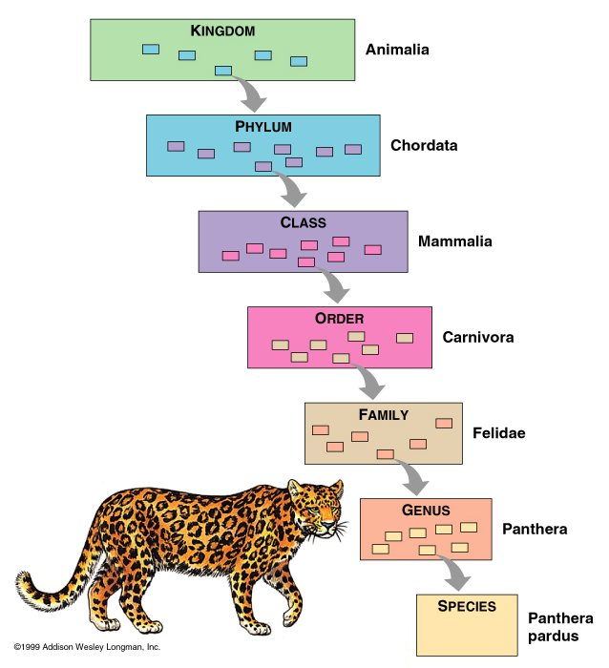

Slide 23
Explain how organisms can be classified using various techniques….
Taxonomists - use a wide variety of information to develop classification that reflects true evolutionary relationships.
This information includes: anatomy (structural), biochemical, cytological, DNA, embryological, behavioral, and fossil information.

Slide 24
What is Nomenclature?
A system for naming living things is called nomenclature.
It consists of naming each species with two names.
The first is the genus name; the second is the species name.
The genus name is always capitalized but the species is not.
They both should be in italics when typed but may be underlined if handwritten

Slide 26
Examples of scientific names include:
Canis familiaris (dog)
Homo sapien (humans)
Castor canadensis (beaver)
Acer rubrum (red maple)

Slide 27
Why don’t we just use common names?
The use of common names can be confusing.
Examples:
The fruit Capsicum frutescens is called mango, bell pepper, sweet pepper or green pepper depending upon where you live.
The woodland flower Cornus canadensis has common names bunchberry and crackerjack.

Slide 28
Taxonomic Keys
A taxonomic key - a to identify organisms already classified by taxonomists. Such keys move from general to specific descriptions.
These keys are dichotomous - paired statements that describe alternative possible characteristics of the organisms.

Slide 29
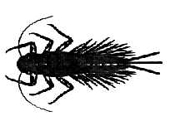
Example: What is the name of this organism?
1. A. Has six legs ………………go to 2
B. Has eight legs …………….go to 4
2. A. Has two antenna …………go to 3
B. Has no antenna ………….Caddius
3. A. Has two hair-like tails ….Stonefly
B. Has three hair-like tails…Mayfly
4. A. Has hook-like claws …….Caddisfly
B. Has no hook-like claws….Damselfly

Slide 30
Six Kingdom System of Classification
Most taxonomists use a six kingdom system of classification. Recently, a five kingdom classification was used but a greater understanding of bacteria lead to dividing this kingdom.
The kingdoms now include:
Bacteria (monera ,bacteria or prokaryotae)
Archaebacteria
Protista
Fungi
Plantae
Animalia

Slide 31
1. Kingdom Bacteria
1. prokaryotic cell type
2. microscopic
3. unicellular body form; some colonial
4. cell wall is composed of peptidoglycan
5. nutrition is obtained through photosynthesis, chemosynthesis and absorption – autotrophs and heterotrophs.
6. nervous system is absent
7. Asexual reproduction
8. locomotion is present in some (flagellum)
Live nearly anywhere
Examples: E. Coli, Clostridium botulinum

Slide 32
2. Kingdom Archeabacteria
Possess unique structures and mechanisms that allow them to live in extreme environments like acidic springs
Cell wall composed of lipids
Examples: methanogens, halophiles, thermoacidophiles
See 1-7 above, omit #4

Slide 33
3. Kingdom Protista
eukaryotic cell type
body form is mainly unicellular; some colonial, some simple multicellular organisms
cell wall will exist in some protists; its composition will vary
nutrition may be through photosynthesis, ingestion, or absorption.
Can be parasitic
Nervous system is absent
Sexual and asexual reproduction
Locomotion is present in some protists
Live in aquatic or moist habitats
Examples: Ciliates, Flagellates, Slime Molds, Diatoms, Algae (autotophs), euglena

Slide 34
4. Kingdom Fungi
eukaryotic cell type
body form is some unicellular; mainly multicellular
cell wall is usually composed of chitin
nutrition is through absorption; secrete enzymes that digests food material outside of itself.
nervous system is absent
Sexual and asexual reproduction
no form of locomotion
Most are terrestrial
Parasites or decomposers
Examples: Molds, Lichens, Yeast, Mushrooms, Bread Molds

Slide 35
5. Kingdom Plantae
eukaryotic cell type
multicellular organisms; specialized tissues and organs
cell wall is composed of cellulose
nutrition is through photosynthesis
nervous system is absent
Sexual and asexual reproduction
no form of locomotion
Most are terrestrial
Examples: Flowering Plants, Conifers, Ferns, Mosses, liverworts, Horsetails, Seaweeds

Slide 36
6. Kingdom Animalia
eukaryotic cell type
multicellular organisms with tissues, organs and organ systems
no cell wall
nutrition is through ingestion
nervous system is present
Sexual reproduction
locomotion distinct at some point in life cycle
Live in terrestrial and aquatic habitats
Exhibit complex forms of behavior
Examples: Sponges, Echinoderms, Jellyfish, Mollusks, Worms, Arthropods, Chordates, Birds, Mammals

