Slide 1
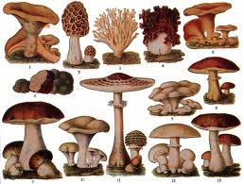
Kingdom Fungi
Pages 152-158 textbook

Slide 2
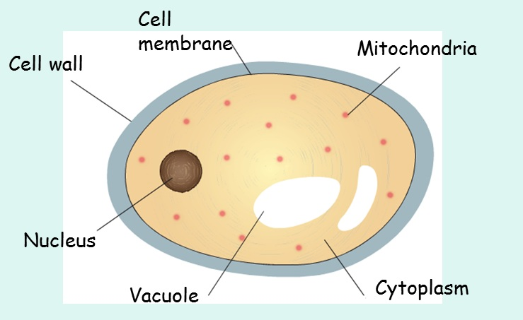
Cell type
Eukaryotic cell

Slide 3
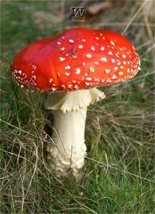
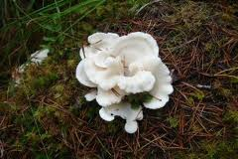
Angel’s Wings
Fly Agaric
http://www.wisc-online.com/Objects/ViewObject.aspx?ID=BIO304

Slide 4
Nutrition
They are heterotrophs
(cannot make their own food)
They get their nutrients from absorption, by secreting enzymes that digests food outside of itself.
Ex: Think of moldy bread
They can also be parasites or decomposers
Ex: Athlete's Foot

Slide 5
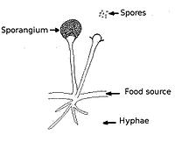

Slide 6
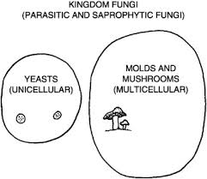
Body Form
Unicellular or Multicellular
(Multicellular is more common)
They have a
cell wall made
of chitin

Slide 7
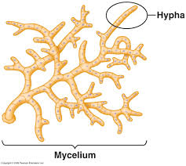
Unique parts of the Fungi body:
1. Hyphae (singular hypha) – the main part of their body, it is a network of fine filaments
2. Mycelium - A loose,
branching network
of hyphae

Slide 8
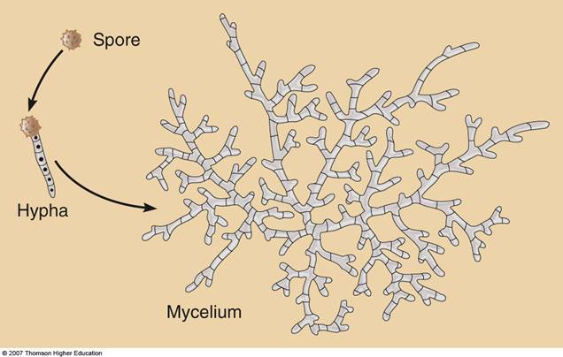

Slide 9
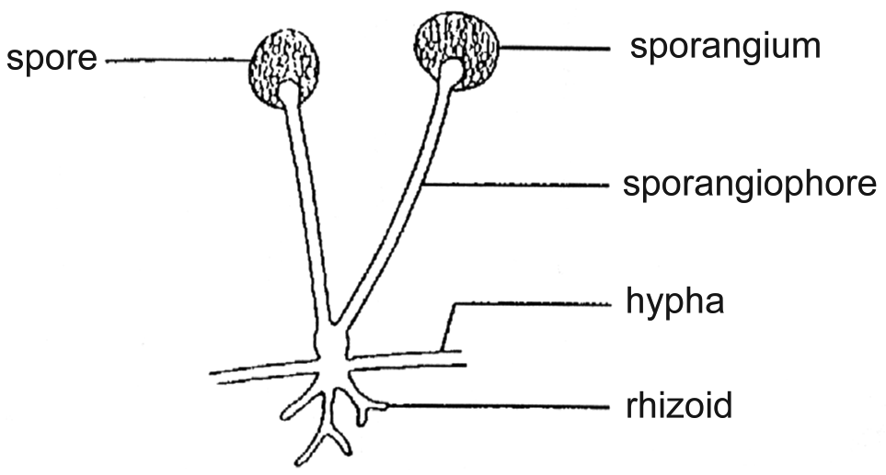

Slide 10
3. Stolons – hyphae that this spreads out over the surface of the bread (you can see this)
4. Rhizoids – the “roots.” It is hyphae that anchors the fungi into food. It secretes enzymes that digest food (the bread) allowing them to absorb the digested nutrients.

Slide 11
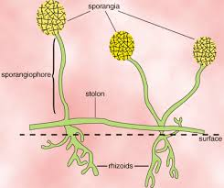

Slide 12
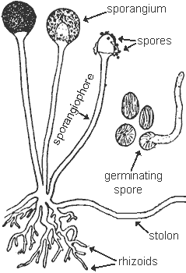

Slide 13
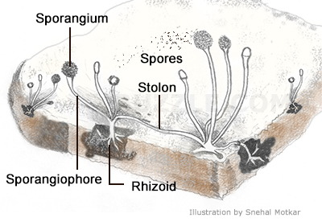
Reproduction
Sexual and Asexual reproduction

Slide 14
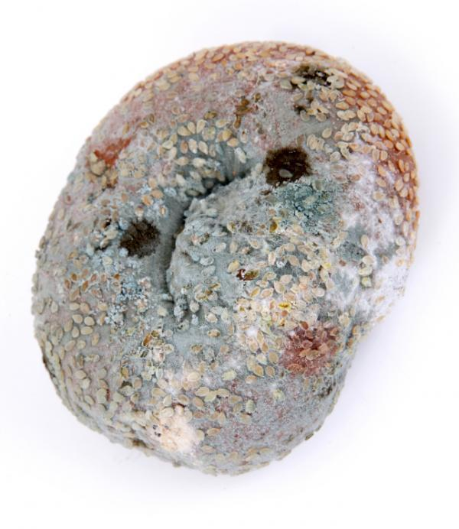

Slide 15
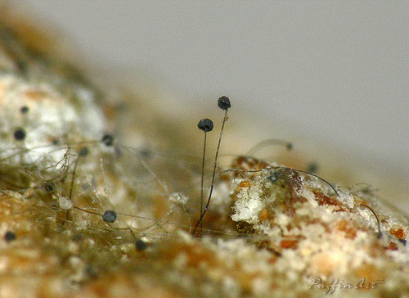

Slide 16
Example of a Fungus Life Cycle (Figure 5.28, p. 154)
Rhizopus stolonifera is the common black bread mould.
It prefers to reproduce by asexual reproduction, but will reproduce by sexual reproduction during unfavorable conditions.

Slide 17
Asexual Reproduction
The bread mould grows sporangiophores
At the end of sporangiophore, there are sporangia
The sporangia contain spores (seeds), which fall to the bread and grow into a new fungi, which is identical to its parent.

Slide 19
Sexual Reproduction
Bread mould is made up of two forms of hyphae, + and - mating strains
This is like male and female parts
+ and - mating strains join together and create a zygospore (its like a baby).
When conditions are right, the zygospore will absorb water and grow into a new fungi, which is NOT identical to its parents.

Slide 20
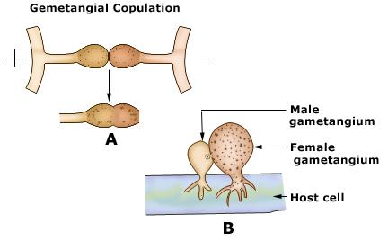

Slide 21
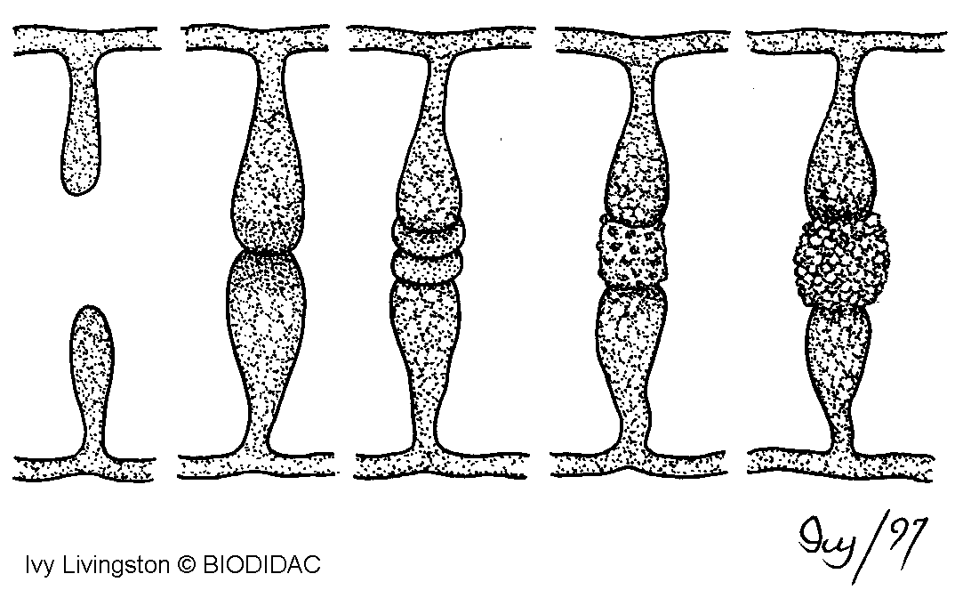

Slide 22
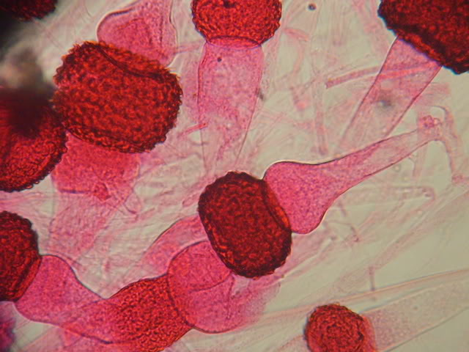

Slide 23
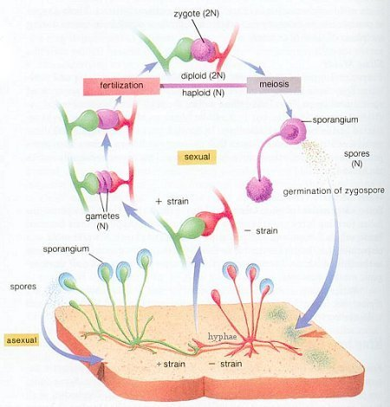

Slide 24
http://bcs.whfreeman.com/thelifewire/content/chp31/31020.html

Slide 25
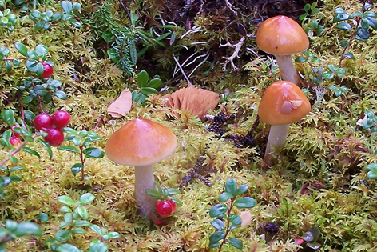
Locomotion
They have no form of locomotion

Slide 26
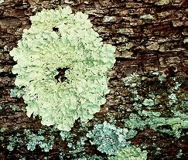
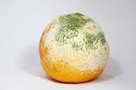
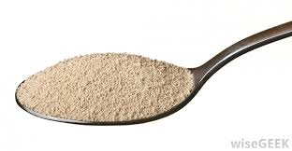
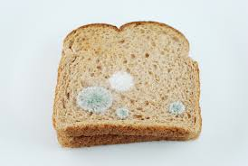
Examples
Molds, Lichens, Yeast, Mushrooms, Bread Molds

Slide 27
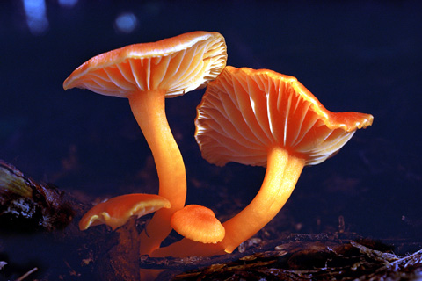
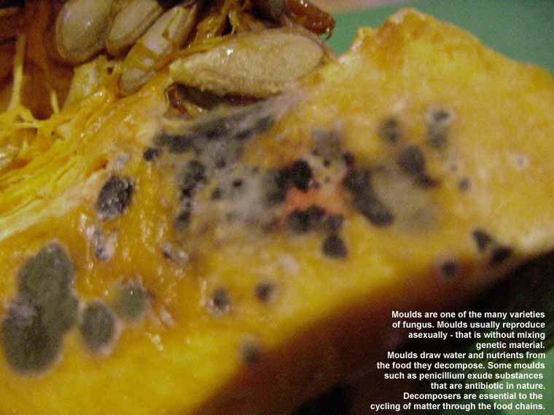
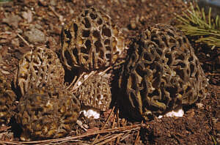
Rhizopus stolonifera
Mushroom - Basidiomycota
Deuteromycota – Fruit moulds - Pennicillium
Ascomycota - Morels

Slide 28
Types of Fungi
Fungi are classified according to their reproductive characteristics.
Name of fungus | Reproductive characteristic | Type of reproduction
Zygomycotes | zygospores | sexual reproduction
Basidiomycotes | basidiospores | sexual reproduction
Ascomycotes | asci | sexual reproduction (spores spread by wind)
Deuteromycotes | conida | asexual reproduction

