Slide 1
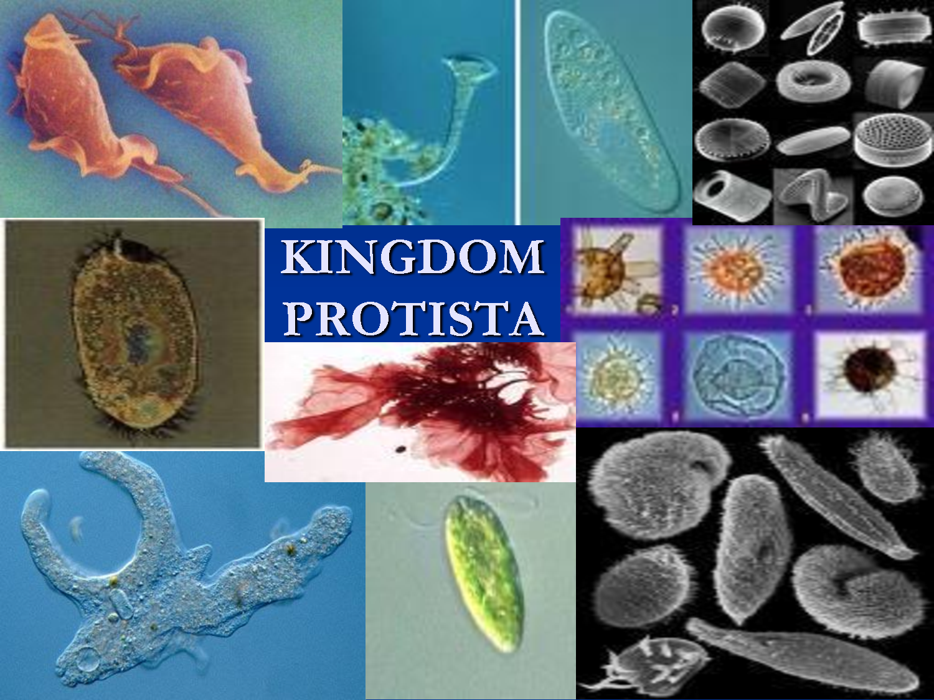

Slide 2
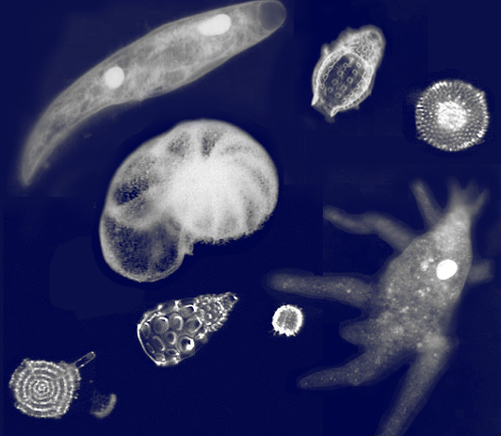
Kingdom Protista
Cell type: microscopic, mostly unicellular, some are multicellular (algae)
ALL are eukaryotic (have a nucleus)
Most live in water (though some live in moist soil or even the human body)
A protist is any organism that is
not a plant, animal or fungus

Slide 3
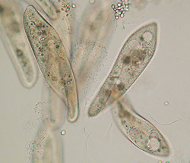
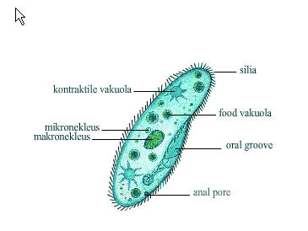
Nutrition: heterotrophic or autotrophic
They are classified into three major groups according to their type of nutrition
Protozoa (animal-like protists) are heterotrophs that ingest or absorb food.

Slide 4
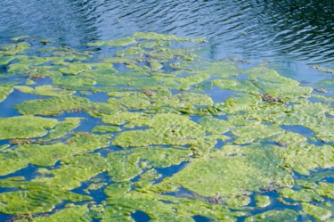
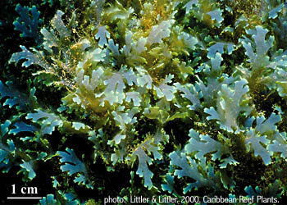
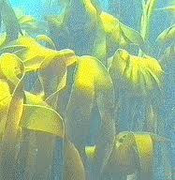
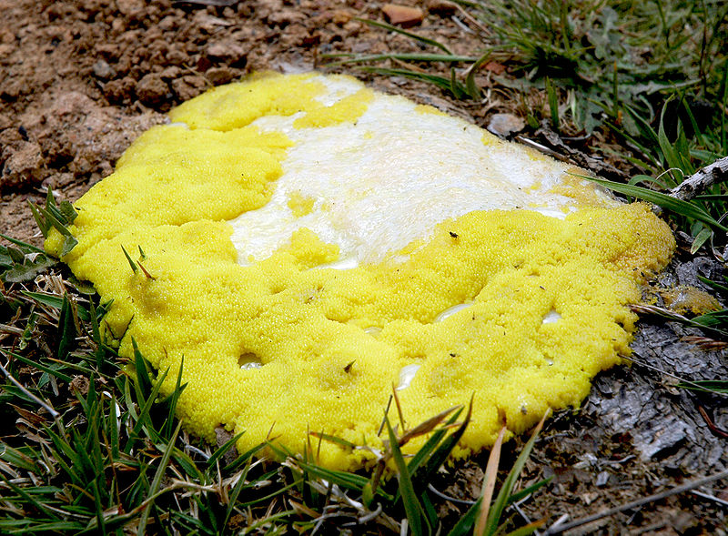
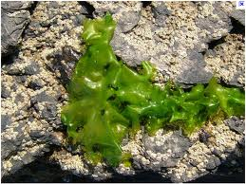
2) Algae (plant-like protists) are autotrophs that carry out photosynthesis.
3) Slime moulds and Water moulds (fungus-like) are saprotrophic, which means they absorb nutrients

Slide 5
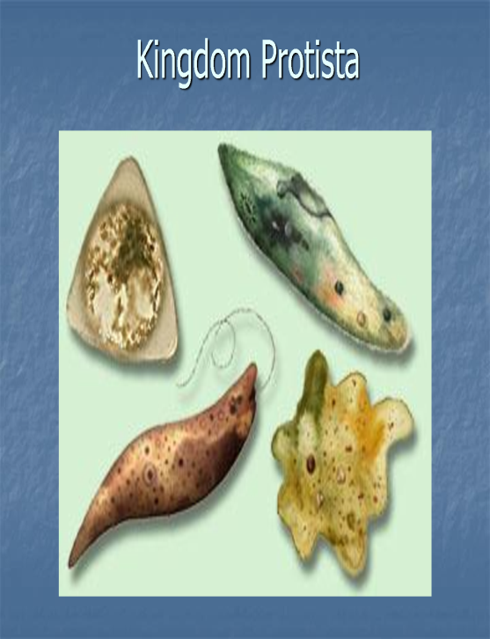
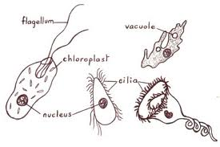
Body type:
They can be like plants - green, make their own food and NOT move around.
They can be like animals - have moving body parts and are able to move around their environments

Slide 6
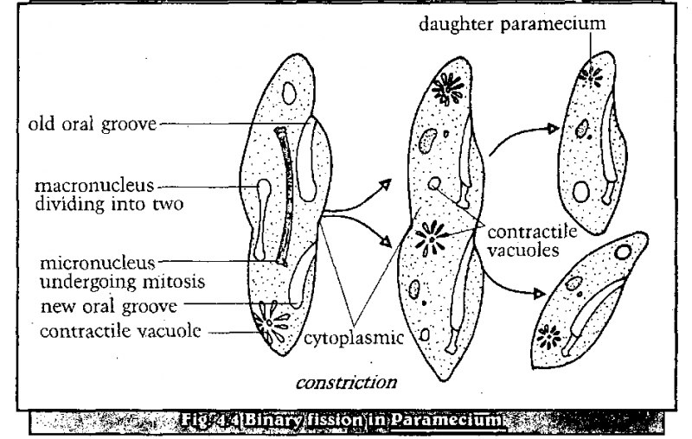
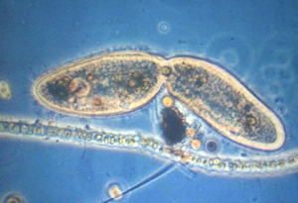
Reproduction: They can do Asexual or Sexual reproduction, depending on the situation.
Asexual reproduction by mitosis, fission, budding, or spores

Slide 7
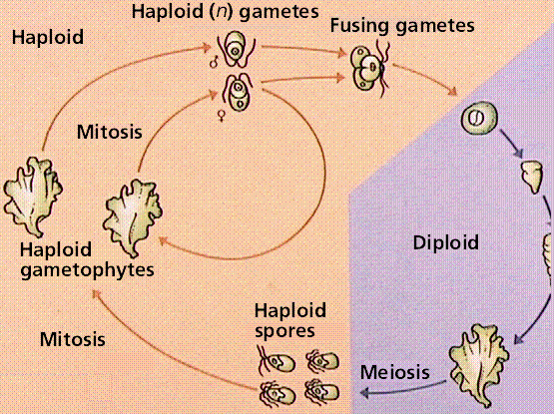
Sexual reproduction – sperm and eggs join together to form a new protist. This happens in water.

Slide 8
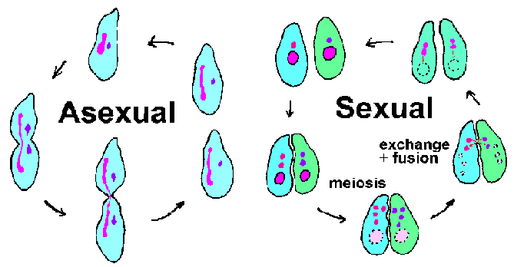
1 parent splits into 2 identical cells
2 parents make Non-identical offspring

Slide 9
Locomotion:
There are 4 Phyla of Animal-like Protists - They are classified by how they move:
Zooflagellates – flagella
Sarcodines – extensions of cytoplasm (pseudopodia)
Ciliates – cilia
Sporozoans – do not move

Slide 10
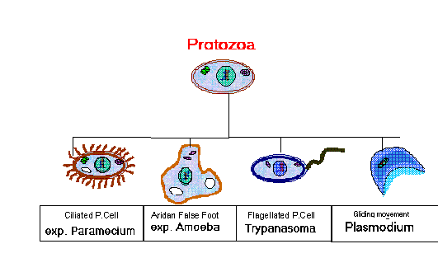

Slide 11
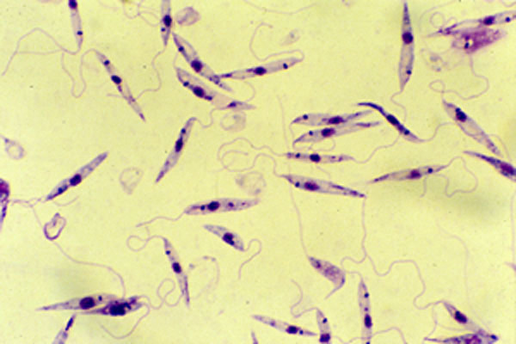
Zooflagellates
move using one or two flagella absorb food across membrane

Slide 12
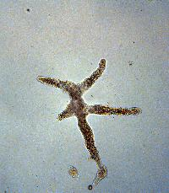
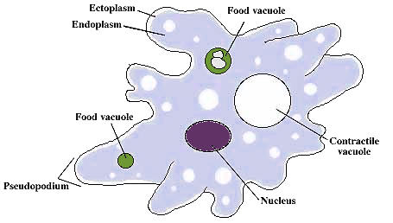
Sarcodines (Ameba)
moves using pseudopodia ( “false feet” ), which are like extensions of the cytoplasm

Slide 13
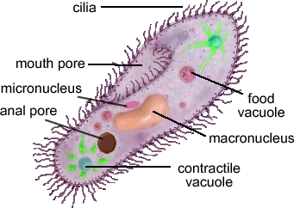
Ciliates (Ex: Paramecium)
move using cilia

Slide 14
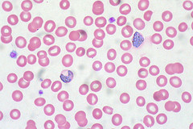
Sporozoans
do not move on their own
They are parasitic
Malaria is caused by a sporozoan (Plasmodium), which infects the liver and blood; It is transmitted by mosquitoes.

Slide 15
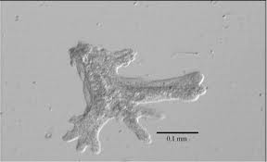
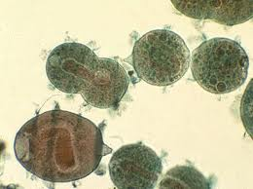
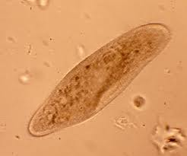
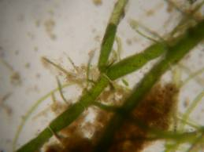
Kingdom Protista Video:
http://www.youtube.com/watch?v=-zsdYOgTbOk
Amoeba
Phylum Ciliophora
Paramecium
Phylum Chlorophyta (Green algae)

Slide 16
Example of a Protist Life Cycle (See Figure 5.15, p. 146)
Plasmodium vivax (a human parasite) is responsible for one type of malaria in humans.
1. A mosquito bites an infected person and ingests red blood cells, which contain the protist.
2. Inside the mosquito’s stomach, the protist reproduces. It forms a zygote (baby) which eventually breaks open releasing the sporozoites (spores).

Slide 17
3. The sporozoites go to the mosquitoes mouth so they can infect a new human host if bitten.
4. Once inside the new human host, sporozoites will go to the liver and reproduce.
5. Once they multiply, they enter the blood and invade red blood cells causing them burst.

Slide 18
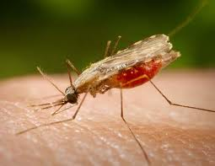
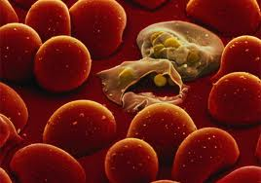
Malaria Animation (Life cycle of a Protist)
http://www.youtube.com/watch?v=OEDhe4MPEMc

