Slide 1
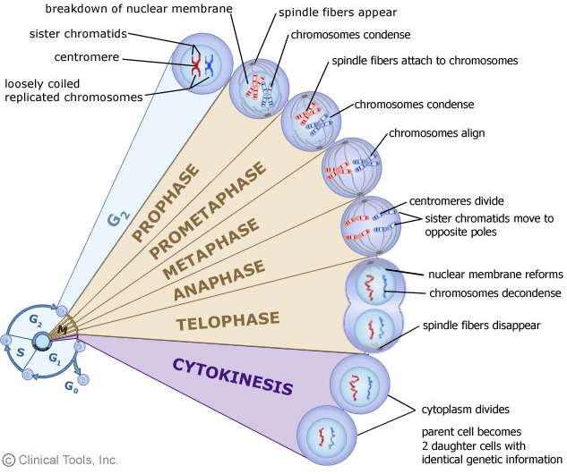
Biology 3201 Important terms
Unit 2: Reproduction & Development

Slide 2
Somatic cell – a body cell; it contains 46 chromosomes
Nucleus – the ‘brains’ of the cell; it contains DNA
Cell membrane – it surrounds the cell; it controls what can enter and leave the cell

Slide 3
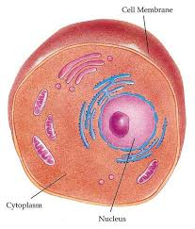

Slide 4
Chromosome – threadlike structure inside the nucleus that is made up of DNA. It carries all of the information used to help a cell grow, thrive, and reproduce.
Chromatin – the DNA and proteins that makes chromosomes
Chromatid - one copy of a duplicated chromosome

Slide 5
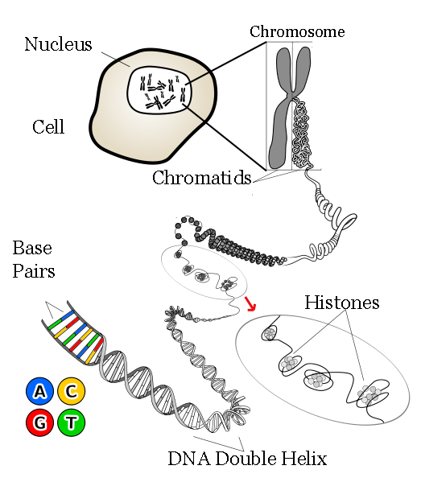
Histone – the structural protein that makes up a DNA molecule
Animation of histones:
http://www.unc.edu/depts/our/hhmi/hhmi-ft_learning_modules/2011/proteinsmodule/histones/index.html

Slide 6
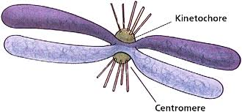
Kinetochore – where spindle fibers attach on the centromere.

Slide 7
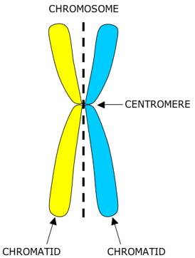
Centromere – the part of the chromosome that joins chromatids together

Slide 8
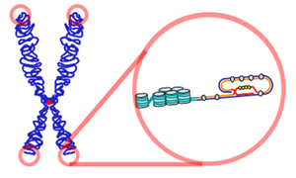
Telomere - a region of repetitive DNA at the end of a chromosome, which protects the end

Slide 9
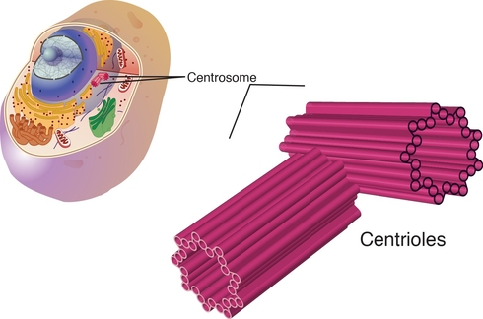
Centrioles – tube shaped structure, made of microtubules, which are used to help the cell divide

