Slide 1
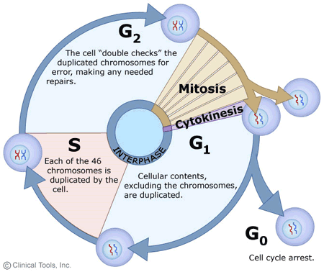
The Cell Cycle, Mitosis & Cytokinesis
Unit 2

Slide 2
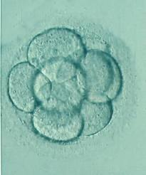
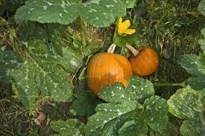
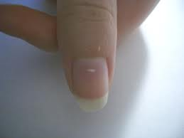
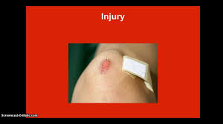

Slide 3
What is the cell cycle?
The cell cycle explains how cells divide. It is a continuous cycle of growth and division, which is necessary to replace broken or worn out cells.

Slide 4
It is divided into two parts:
Growth stage - also called Interphase
2) Division stage – this stage includes Mitosis and Cytokinesis

Slide 5
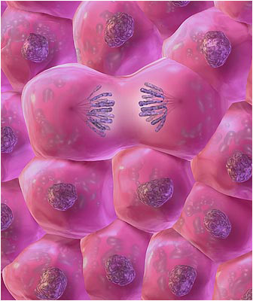
What happens during the growth phase (interphase)?
In this stage, the cell increases its volume and mass. It gets BIGGER!

Slide 6
Gap 1 (G1) – cells carry out metabolic activities to prepare for cell division. Ex: make energy
S phase - DNA synthesis and replication occur
Gap 2 (G2) - the cell prepares to divide

Slide 7
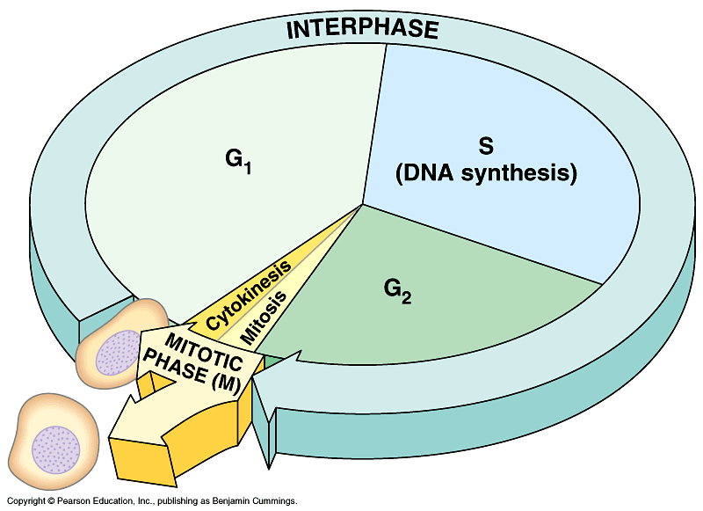

Slide 8
Why do cells need to divide?
New cells are needed for growth maintenance and repair
Cells must regenerate damaged tissues
Cells that do not function properly must be replaced
Cells die and need to be replaced (Ex: blood cells)
Chromosome number must be maintained (Ex: humans have 46 chromosomes in somatic cells)

Slide 9
What is mitosis? - When the nucleus divides
What is Cytokinesis? – When the cytoplasm divides
Both must occur for the cell cycle to be complete

Slide 10
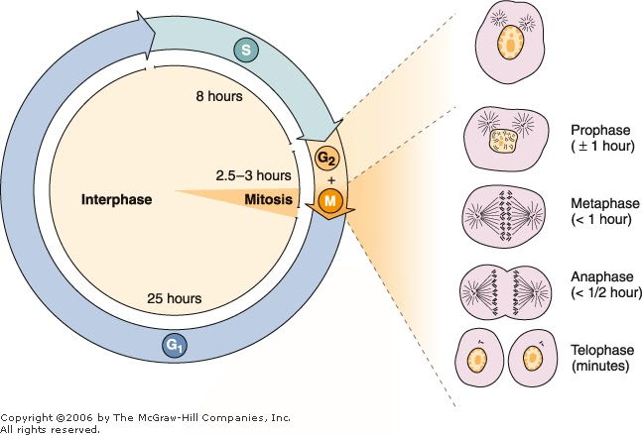

Slide 11
How does Mitosis work?
When human somatic cells undergo mitosis, a parent cell divides to produce two daughter cells. These daughter cells are genetically identical to the original parent cell. In mitosis, new cells are exact copies of previously existing cells.

Slide 12
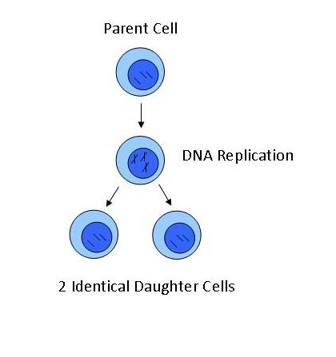
Parent cell divides into 2 daughter cells

Slide 13
What are the stages of Mitosis?
WHAT HAPPENS IN PROPHASE?
Chromatin coils and thickens forming chromosomes
The nuclear membrane disappears
Centrioles migrate to opposite ends of the cell
Spindle fibers form between the two centrioles

Slide 14
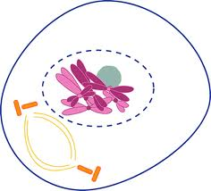

Slide 15
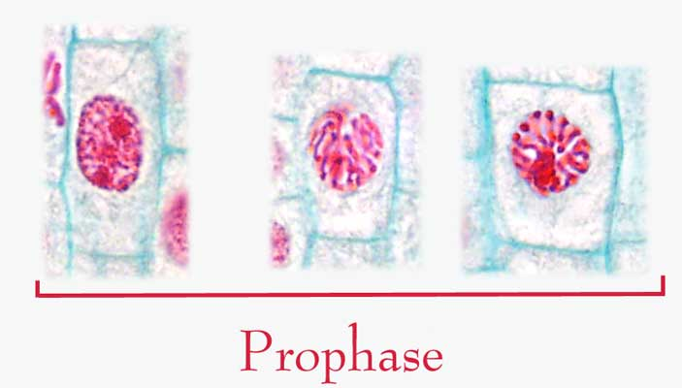

Slide 16
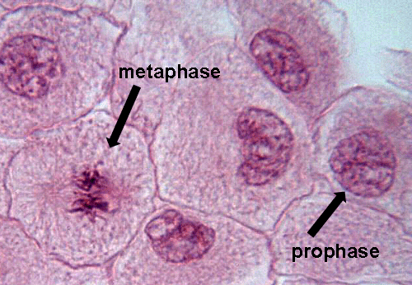

Slide 17
WHAT HAPPENS IN METAPHASE?
Spindle fibers attach to centromere
Spindle fibers from one pole attach to one chromatid and spindle fibers from the other pole attach to the other chromatid
Chromatids are guided to the cell’s equator, called the metaphase plate

Slide 18
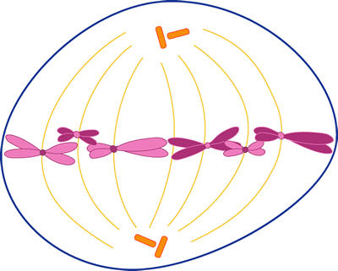

Slide 19
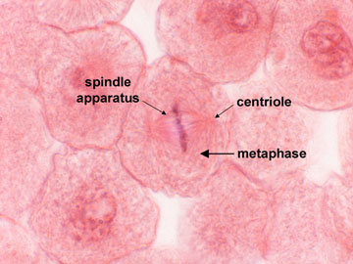

Slide 20
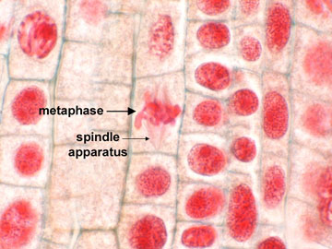

Slide 21
WHAT HAPPENS IN ANAPHASE?
Centromere splits apart and chromatids are pulled to opposite poles of the cell by spindle fibers.

Slide 22
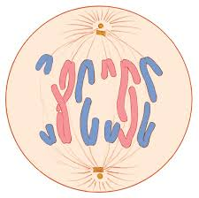

Slide 23
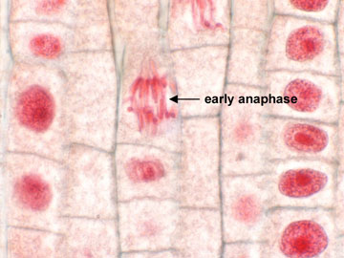

Slide 24
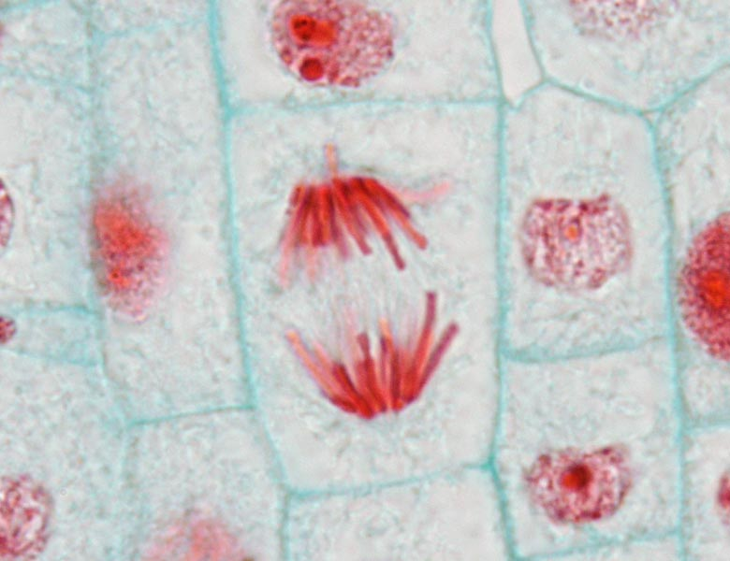

Slide 25
WHAT HAPPENS IN TELOPHASE?
Chromatids have reached opposite poles and are now a single, non-replicated chromosome
Spindle fibers are not needed so they break down and disappear
Nucleolus reappears and the nuclear membrane forms around each new set of chromosomes.

Slide 26
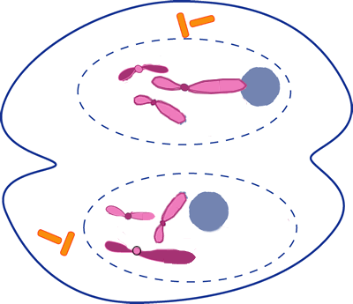

Slide 27
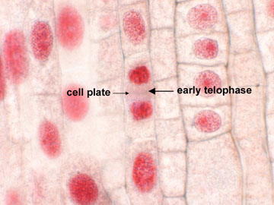

Slide 28
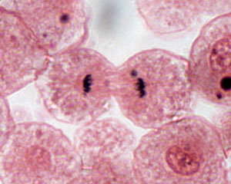

Slide 29
Mitosis Videos
http://www.cellsalive.com/mitosis.htm
http://highered.mcgraw-hill.com/olcweb/cgi/pluginpop.cgi?it=swf::535::535::/sites/dl/free/0072437316/120073/bio14.swf::Mitosis%20and%20Cytokinesis

Slide 30
What is Cytokinesis?
This is defined as the separation of the cytoplasm and the formation of two new daughter cells.
In animal cells, the cell membrane becomes indented, pinching off to form two daughter cells. This process is called cleavage.
In plant cells, a cell plate begins to form, which eventually turns into the cell wall, as the cell divides.

Slide 31
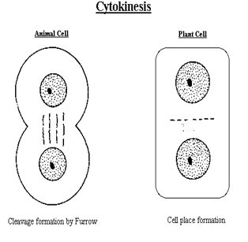
Explain how cytokinesis happens in animal and plant cells?

Slide 32
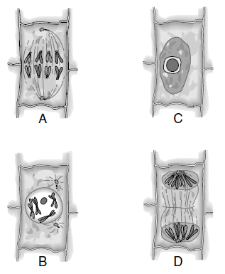
Practice Question: Label each stage of mitosis. Justify your response.

Slide 33
What is cancer?
http://www.youtube.com/watch?v=SGaQ0WwZ_0I&safe=active
http://www.youtube.com/watch?v=BmFEoCFDi-w&safe=active

Slide 34
Why do we use radiation and chemotherapy to treat cancer?
Cancer cells divide more rapidly than any other type of body cells. Therefore, anything that interferes with cell division will affect cancer cells more than healthy cells.
This is the basis for radiation and chemotherapy.

Slide 35
What is radiation therapy?
The goal of radiation therapy is to focus the radiation on the diseased part of the body and avoid affecting healthy tissue. It directs radiation (x-rays & gamma rays) at the cancer.
It works by damaging the chromosomes in a cell. As a result, the cell cannot divide. Unfortunately, healthy cells also get damaged, but most cells can eventually repair themselves.

Slide 36
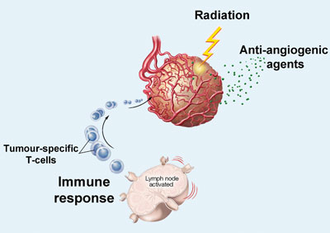

Slide 37
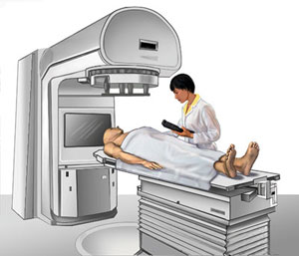
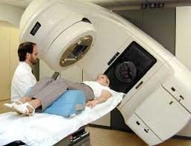
http://www.youtube.com/watch?v=_moypMx05Fw

Slide 38
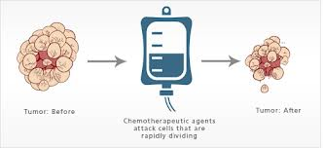
What is chemotherapy?
Medicine that is injected into the body.
One or more types of drugs are used
The medication attacks dividing cells as they divide or they can prevent cells from dividing
http://www.youtube.com/watch?v=VRhz3DhjG5M

Slide 39
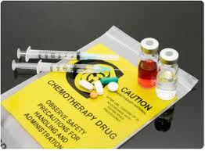
Chemo affects the entire body, healthy cells too
This treatment may be used alone or in combination with radiation.

Slide 40
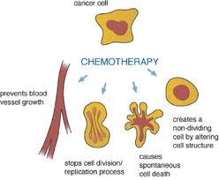

Slide 41
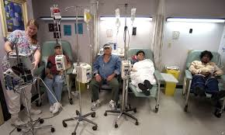

Slide 42
What are possible side effects of cancer treatments?
Radiation:
Skin inflammation and fatigue
Specific side effects depending on location of treatment (Ex: brain - hair loss; testicular cancer – sterility)

Slide 43
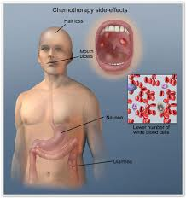
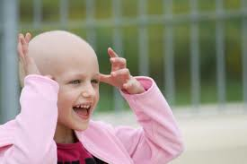
Chemotherapy:
Hair loss
Nausea
Diarrhea

Slide 44
For both treatments, side effects usually last only for the duration of the treatment. However, sterility can be permanent.
Radiation and Chemotherapy treatments are particularly harmful to body cells that divide quickly, such as bone marrow cells, skin cells, hair cells, cells in the GI (gastrointestinal) tract and cells of the reproductive system.

Slide 45
What are the goals of cancer research?
Prevention
To find out why cells divide uncontrollably
Find treatment that affects cancerous cells and leaves healthy cells unharmed

