Slide 1
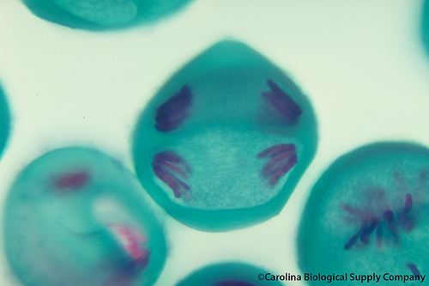
Meiosis

Slide 2
Important terms:
Diploid (2n) means having paired chromosomes
Haploid (n) means single chromosomes (NOT paired)
In human somatic (body) cells there are 46 chromosomes (23 pairs) therefore we say this is diploid (2n)
In human sperm or egg cells there are 23 chromosomes (half the number of chromosomes) therefore we say this is haploid (n)

Slide 3
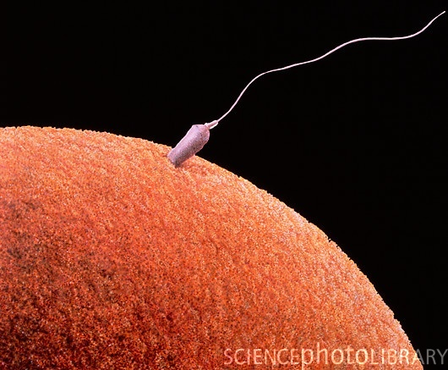
Gamete – a sex cell (ex: sperm or egg)

Slide 4
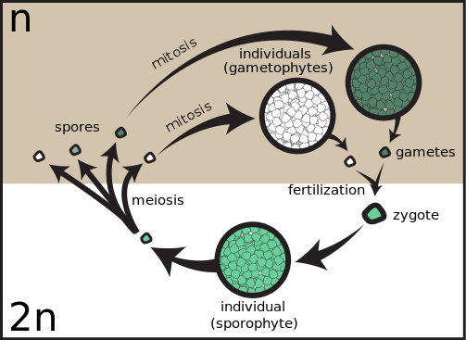
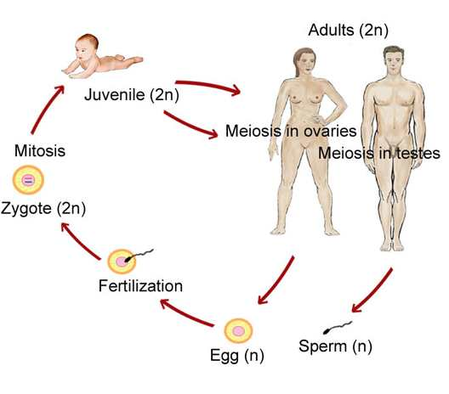
What is meiosis?
Meiosis is a process that makes gametes
In animals, this process makes sperm and eggs.
In plants, this process makes spores or seeds.

Slide 5
What are the phases of Meiosis?
Meiosis is similar to mitosis, but there is an extra set of phases for each stage.
Since there is an extra set of phases they are labeled Meiosis I and Meiosis II
As in mitosis, chromosomes replicate prior to cell division

Slide 6
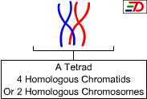
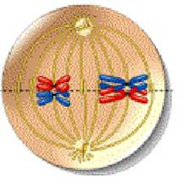
What is a tetrad?

Slide 7
What are homologous chromosomes?
Also called a tetrad
They contain genes for the same traits
(ex: blue eyes from mom & green eyes from dad)
One of each homologous pair came from the father (paternal) and one came from the mother (maternal)

Slide 8
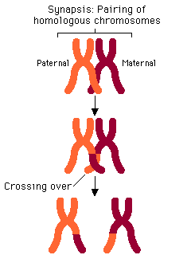
What is the Synapsis?
The place where homologous chromosomes (tetrads) line up

Slide 9
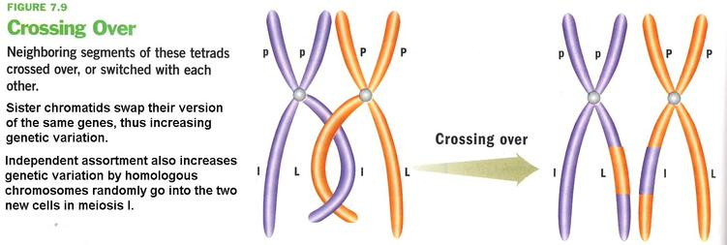
What is crossing over?
The exchange of genetic material between homologous chromosomes during synapsis
http://highered.mcgraw-hill.com/sites/0072495855/student_view0/chapter28/animation__random_orientation_of_chromosomes_during_meiosis.html

Slide 10
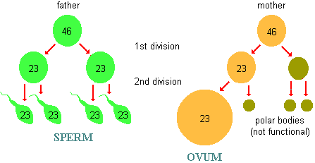
What is reduction division?
Cell division that produces reproductive cells. The parent cell divides into four daughter cells each containing half the number of chromosomes

Slide 11
What makes Meiosis different from Mitosis?
Meiosis involves two separate cell divisions (Meiosis I and Meiosis II)
The resulting daughter cells have half the number of chromosomes as the parent cell. Therefore daughter cells are NOT identical to parent cell.

Slide 12
In meiosis, a diploid cell (2n) produces four haploid (n) daughter cells
Meiosis I - reduces the number of chromosomes from diploid to haploid. This is referred to as reduction division.
Meiosis II – is the same as mitosis

Slide 13
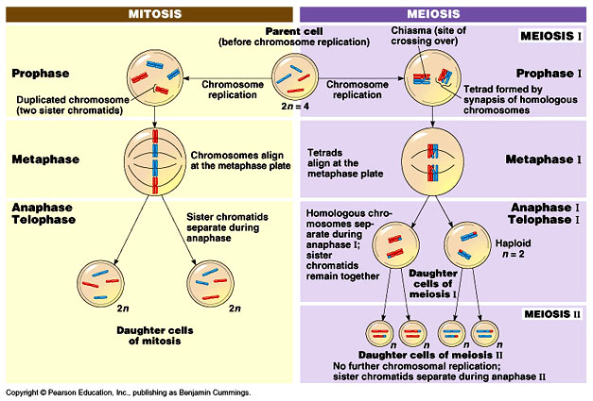

Slide 14
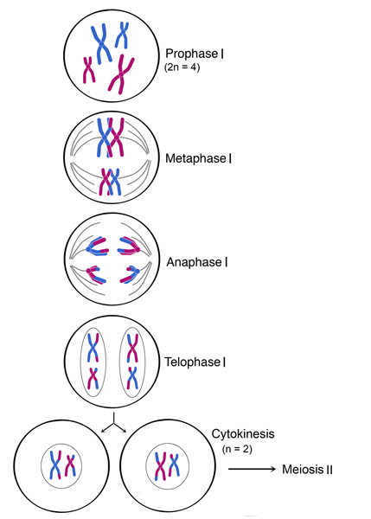
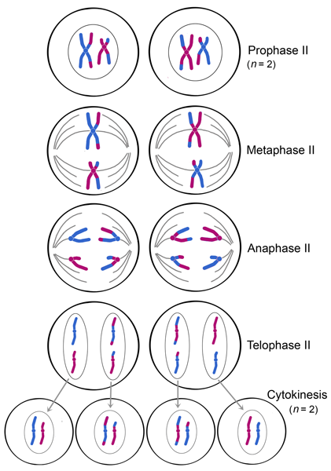
Phases of Meiosis
There are 8 phases (stages) of Meiosis

Slide 15
PROPHASE I
The nuclear membrane begins to disappear
Centrioles move to opposite poles and spindle fibers are made
Chromosomes come together in homologous pairs, this structure is called a tetrad because it consists of 4 chromatids
During this time crossing-over can occur

Slide 16
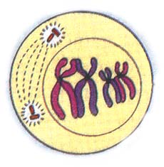
http://highered.mcgraw-hill.com/sites/0072495855/student_view0/chapter28/animation__random_orientation_of_chromosomes_during_meiosis.html

Slide 17
Over view of Prophase I: Chromosomes form, homologous chromosomes start to pair up and crossing over can occur. This creates more genetic diversity.

Slide 18
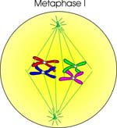
METAPHASE I
Chromosomes line up in middle of cell, but they line up in HOMOLOGOUS PAIRS
Crossing-over can occur here too

Slide 19
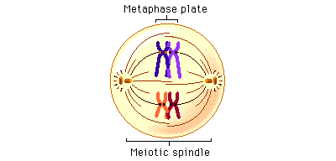

Slide 20
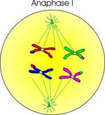
ANAPHASE I
Chromosomes are pulled apart, but it is DIFFERENT than mitosis.
The centromeres DO NOT divide, instead chromosomes stay together.
One chromosome from each homologous pair is pulled to opposite ends of the cell.

Slide 21
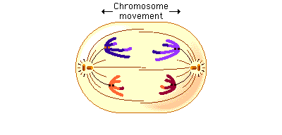

Slide 22
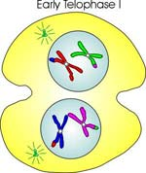
TELOPHASE I
The cell contents divide.
The nuclear membrane may reappear, but cell usually goes into Prophase II.

Slide 23
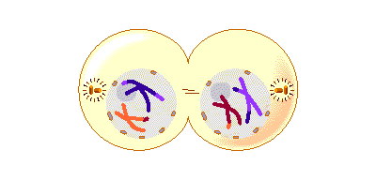

Slide 24
What is the result of meiosis I?
At the end of Meiosis I, each of the two cells has HALF the original number of chromosomes
One chromosome from each original homologous pair.
Since the chromosome number is halved, Meiosis I is referred to as reduction division.
The two haploid daughter cells are NOT identical

Slide 25
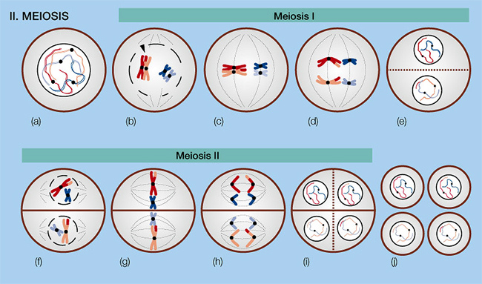
http://www.phschool.com/science/biology_place/biocoach/meiosis/proii.html

Slide 26
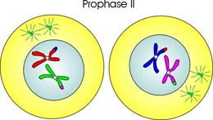
MEIOSIS II
Meiosis II is exactly like mitosis.
Prophase II – Chromosomes appear and nuclear membrane breaks down (if present)

Slide 27
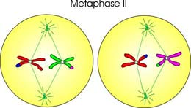
Metaphase II – Chromosomes line up at centre of cell and attach to spindle fibers

Slide 28
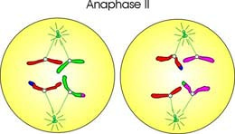
Anaphase II – Centromeres divide. Replicated chromatids are pulled to opposite ends of the cell

Slide 29
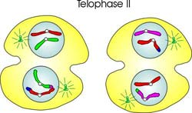
Telophase II – Cell contents divide. Chromosomes uncoil, New nuclear membrane develops

Slide 30
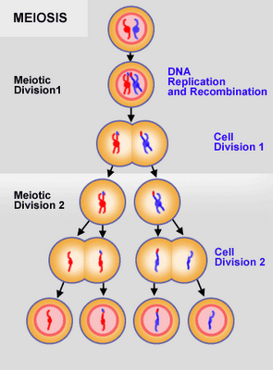
http://highered.mcgraw-hill.com/sites/0072495855/student_view0/chapter28/animation__how_meiosis_works.html
Stages of Meiosis (McGraw-Hill)
http://highered.mcgraw-hill.com/sites/0072495855/student_view0/chapter28/animation__stages_of_meiosis.html

Slide 31
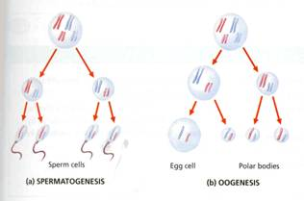
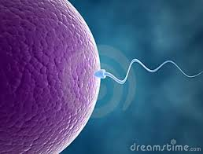
What is the result of Meiosis II?
4 cells are formed, each having half the number of chromosomes as the original cell
In males these cell will turn into 4 sperm
In females these cell will turn into 1 egg and 3 polar bodies

Slide 32
What makes Meiosis different from Mitosis?
http://highered.mcgraw-hill.com/sites/0072495855/student_view0/chapter28/animation__unique_features_of_meiosis.html
Synapsis
Crossing over (homologous pairs)
Reduction division

Slide 33
Practice Multiple Choice
1. If the egg cell of a potato plant has 24 chromosomes, how many chromosomes are found in the root cell?
(A) 12
(B) 24
(C) 36
(D) 48

Slide 34
2. Which process repairs damaged tissue?
(A) meiosis
(B) mitosis
(C) parthenogenesis
(D) spermatogenesis

Slide 35
3. Which best describes the daughter cells at the end of meiosis?
(A) four diploid
(B) four haploid
(C) two diploid
(D) two haploid

